Slide 1
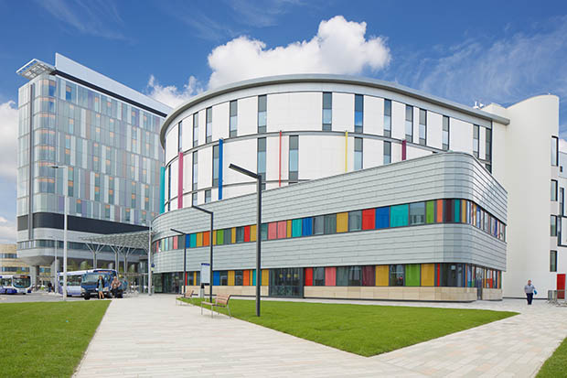
Certificate of Completion
This is to certify that
Deborah Smith
Has successfully completed the following learning module;
Capnography in Recovery
This module comprised a self-learning workbook and a mandatory assessment
Neal Willis
Consultant Anaesthetist
Royal Hospital for Children

