Slide 1
Emergency Paediatric Tracheostomy Management
Neal Willis
7th September 2018
nealwillis@nhs.net

Slide 2
Background
“Algorithms must be available for all staff for accidental decannulation of the trachea and a step-wise approach to management of the compromised airway”

Slide 3
NTSP

Slide 4
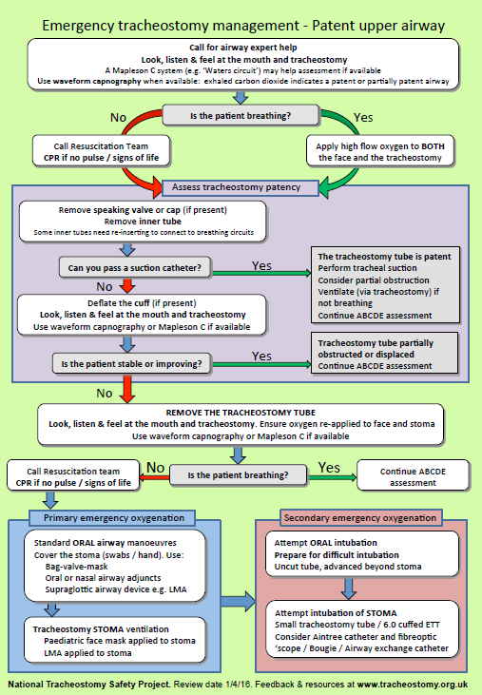

Slide 6
A Couple of Years Later...
Resources available for use in paediatrics
www.tracheostomy.org.uk

Slide 8
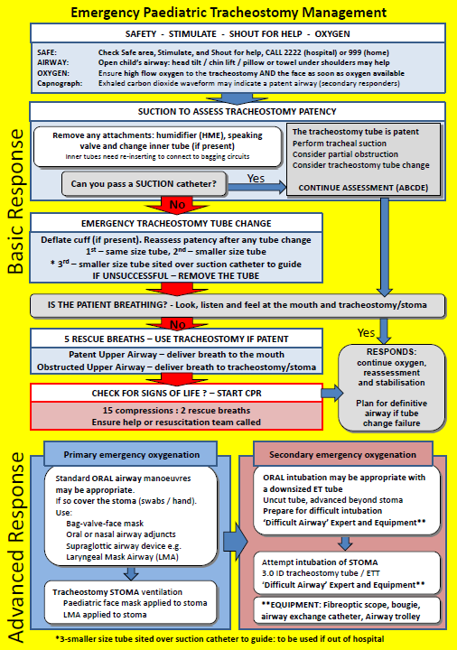

Slide 9
Basic Response (1)

Slide 10
Basic Response (2)

Slide 11
Basic Response (3)

Slide 12
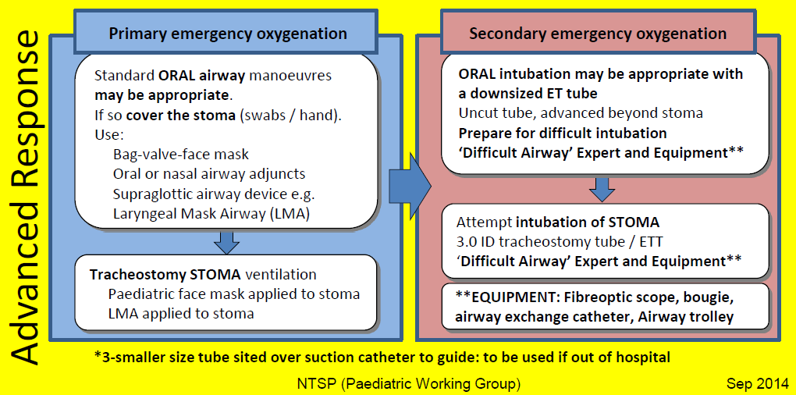
Advanced Response

