Slide 1
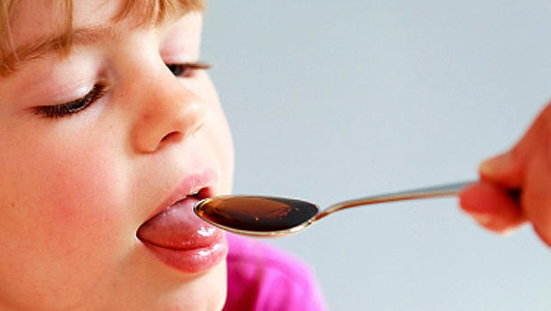
Codeine in children – the way forward in paediatric practice?
Michael Tremlett
Department of Anaesthesia, James Cook University Hospital,
Middlesbrough

Slide 2

Volume 6, Issue 12 July 2013
Latest advice for medicines users
Summary
Codeine should only be used to relieve acute moderate pain in children older than 12 years and only if it cannot be relieved by other painkillers such as paracetamol or ibuprofen alone.
Furthermore, a significant risk of serious and life-threatening adverse reactions has been identified in children with obstructive sleep apnoea who received codeine after tonsillectomy or adenoidectomy (or both). Codeine is now contraindicated in all children younger than 18 years who undergo these procedures for obstructive sleep apnoea
Notes:
Problem from UK perspective = this safety notice from MHRA

Slide 3
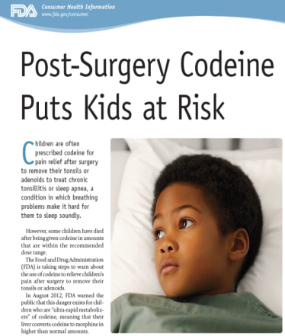
Codeine
Reviews by other Regulators:
20 February 2013.
Advice given by FDA:
Black box formal warning issued:
Children should not receive codeine after tonsillectomy and / or adenoidectomy.
Codeine should only be used in other situations in children if benefits are anticipated to outweigh the risks
If codeine is used parents should be advised to monitor their child for signs of morphine overdose.

Slide 4
OUTLINE:
Background leading up to these safety warnings
Alternative Analgesic Agents available
  Strengths and weaknesses
Conclusion
  What should we prescribe as step up analgesia for children after intermediate surgery in hospital and to take home?
(Providing effective post operative pain relief = multi factorial
This presentation takes a narrow approach focusing on pharmacology only)

Slide 5

Should I still be using Codeine in children?
Are there more effective AND safer alternative agents than codeine to manage pain inadequately controlled by regular paracetamol and NSAIDs?
There is insufficient information available for anyone to give you authoritative answers to these questions
Notes:
All I can do is give you the evidence that is available for you to make a personal judgement.

Slide 6
Why did Regulators issues these safety notices on codeine?
Two publications:
3 deaths and 1 severe respiratory depression in children in North America after tonsillectomy, almost certainly directly related to codeine.
Notes:
Need to go back to the world of Primary FRCA pharmacology

Slide 7

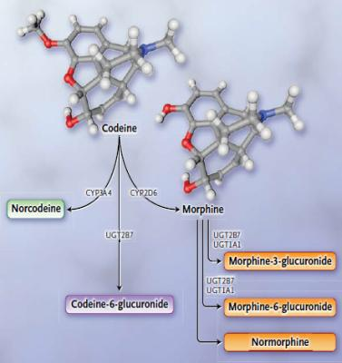
Pharmacokinetics of Codeine
Codeine = 3 Methyl morphine
Metabolism:
70-80% = conjugated in liver to codeine-6- glucuronide (activity unknown)
UDP glucuronyltransferase enzymes
10% N-demethylated to norcodeine (no activity) CYP3A4
5-10% O-demethylated to morphine CYP 2D6

Slide 8

Pharmacokinetics of Codeine
Why does it matter?
Codeine = Pro-drug
Codeine = No analgesic activity
Analgesia dependant on conversion to morphine (and on to active morphine-6-glucuronide) by the Cytochrome P-450 isoenzyme 2D6 (CYP2D6)

Slide 9
Pharmacokinetics of Codeine
Cytochrome 2D6 Enzyme system:
Responsible in part for metabolism of 25% of all drugs
  Tricyclics, SSRIs, Antiemetics (Ondansetron), Beta blockers (Metoprolol)
  2nd most important CYP enzyme in drug metabolism
Marked variation in Genotypes (> 80 allelic variants) due to:
  multiple gene mutations
  gene deletion and multiplications
  gene duplications
Results in multiple different Phenotypes (levels of functional CYP 2D6 activity)
This variation = Genetic Polymorphism

Slide 10
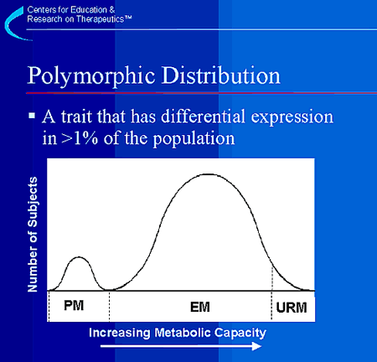
Pharmacokinetics of Codeine
Cytochrome 2D6
Four different levels of enzyme activity = described:
Metabolisers:
Poor = (PM) = 2 defective genes
Intermediate (IM) – 1 defective,
1 normal gene
Extensive (EM) = the Norm
= 2 genes of
normal activity
Ultra-rapid (UM) = gene duplication
(>2 genes)

Slide 11
Pharmacokinetics of Codeine
UK (Caucasian):
7% = Poor metabolisers
0.03% = Ultra rapid metabolisers
Substantial minority receive no effective analgesia from Codeine
Small percentage at risk of excessive plasma morphine concentrations with standard oral dose regimes.
Ethiopians = 29% Ultra rapid metabolisers
Saudis = 21% Ultra rapid metabolisers

Slide 12
Codeine
Adverse Case reports
Letter to the editor:
2 years old 13kg
OSA (sleep study proven)
Adenotonsillectomy
Day Case discharge :
On regular paracetamol and codeine 10-12.5mg 4-6 hrly as needed
Day 1 post op developed temperature + wheeze
Found dead 9AM on 2nd morning post surgery

Slide 13
Codeine
Adverse Case reports
Letter to the editor:
At post mortem:
Evidence of aspiration + bilateral consolidation (bronchopneumonia)
Blood morphine level = 32 ng/ml
Codeine = 0.7mg/l
(Serum morphine concentrations >20ng/ml = associated with respiratory depression in young children)
CYP2D6 Genotyping = Functional duplication of CYP2D6 =Ultra rapid metaboliser

Slide 14
Codeine
Adverse Case reports
Pediatrics (April 2012)
Case series of 3 additional cases of fatal or life threatening episodes in children who had received codeine after Adenotonsillectomy
Age Weight | Condition | Ethnicity | Doses codeine received | Blood morphine levels | Geno - type | Outcome
4 years 28kg Obese | “OSAS” | Inuit | X 4 (8mg / dose) | 17.6ng/ml | UM | Dead Day 3
3 years 14kg | “OSAS” | Middle Eastern | X4 (15mg /dose) | 17 ng/ml | EM | Unresponsive and resuscitated
5 years 29kg Obese | Rec tonsillitis Snoring | ? Southern US | X6 (6mg / dose) | 79 mg/ml | UM | D/Case discharge Dead 24 hrs post op

Slide 15
Codeine
Common factors in problem cases:
All from North America
Received codeine regularly not “as required” for breakthrough pain
All post tonsillectomy for “sleep disordered breathing”
All relatively young (aged 2-5 years) and a number were obese

Slide 16
Codeine
Why problems with tonsillectomy?
 | OSA n=13 | Control n=23 | P value
Minute ventilation mls/kg/min | 115 +- 82 | 158 +- 82 | n= 0.2
Baseline Pe’CO2 /torr | 49 +-1.4 | 42 +-4.9 | n < 0.001
13 children with sleep study proven OSA (mean age = 4 years)
All children gaseous induction
Stabilised Fe’ [halothane] = 1%
Fe’CO2 and Minute Ventilation measured
Notes:
We know that a proportion of children with SDB are acutely sensitive to respiratory depressant effects of inhalational agents and more importantly to opioids. This was elegantly demonstrated in work from Sydney more than a decade ago.

Slide 17
Codeine
Why problems with tonsillectomy?
Children administered Fentanyl 0.5mcg/kg iv.
 | OSA n = 13 | Control n = 23
Number becoming apnoeic | 6 (46%) | 1 (5%) | χ²< 0.001
Pe’CO2 after fentanyl /torr | 55 (+-3) | 49 (+-1) | 0.002
Fall in ventilation mls/kg/min | 79 (+-55) | 65 (+-130) | NS
A proportion of children with OSA show acute sensitivity to opioids.
Waters et al. Journal Applied Physiology (2002) 92; 1987-94

Slide 18
Codeine
Summary
Pharmacodynamics:
Long history of clinical usage as step up analgesia
Familiarity with doses and side effects
Very few case series to demonstrate efficacy (NNT = 16.7 CI= 11-48)
Pharmacokinetics
Theoretically unlikely to provide effective analgesia in minority of patients
Possibility of life threatening respiratory depression in very small sub group of patients (No recorded UK cases)
Pharmaceutical:
Cheap, relatively palatable, child friendly preparation
Schedule 5 drug - Misuse of Drugs Regulations (2001).
  available as a “take home” medication with none of the prescribing issues of higher morphine concentrations
Strong statement from UK regulatory agency saying should no longer be used.
Notes:
NNT to treat the number of adults patients needed to receive a dose for one to get a 50% reduction in acute post operative pain over 4-6 hours) 60mg orally in adults.

Slide 19
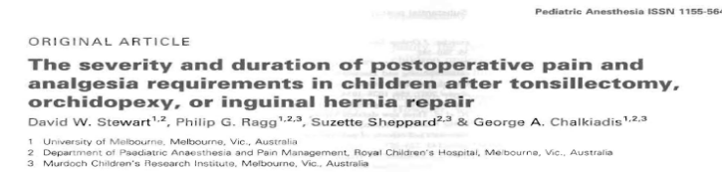
Do we need to provide step up analgesia after intermediate surgery in children?
Review of Pain at home following tonsillectomy, orchidopexy or Inguinal hernia repair:
50% children had significant pain post tonsillectomy up to Day 7 post op
54% of tonsillectomies presented to their GPs within 7 days of surgery because of severe pain
GP prescriptions included Oxycodone, Tramadol , morphine and dextropropoxyphene

Slide 20
Possible Alternatives:
1. Low Dose oral Morphine (Oramorph)
Pharmacodynamics:
Known to be a potent effective analgesic agent in most children NNT =2.9 (adult 10mg im)
Extensive “in patient” clinical experience of drug
No case series of use as “take home” analgesia for intermediate surgery in children to assess efficacy and safety.

Slide 21
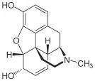
Possible Alternatives:
1. Low Dose oral Morphine (Oramorph)
Pharmacokinetics:
Not a pro drug
Reasonable oral bioavailability (50%)
Metabolism does not involve CYP 2D6 enzyme system
Metabolised to:
  Morphine -3 – glucuronide (70%)
  Morphine-6- glucuronide (10% )
  = active potent metabolite
  = accumulates with repeated dosage

Slide 22
Possible Alternatives:
Low Dose oral Morphine (Oramorph)
Pharmaceutical:
Schedule 5 drug (Misuse of Drugs Regulations 2001).
Cheap
Child friendly preparation

Slide 23

Possible Alternatives:
2. Tramadol:
Centrally acting synthetic analgesic
Mu opioid receptors agonist
Inhibition of noradrenaline reuptake
Increased release + reduced reuptake of serotonin .

Slide 24
Possible Alternatives:
2. Tramadol:
Pharmacodynamics:
Extensive experience (> 10 years of use) as a take home analgesia for breakthrough pain in children in New Zealand
Effective analgesic in studies using a paediatric dental extraction model of pain
No case series of effectiveness post tonsillectomy in literature
Number needed to treat (NNT) = 4.6 (adult data – Tramadol 100mg)
Reduced theoretical potential for respiratory depression compared to conventional opioids
Reputation for increased incidence of increased PONV and
convulsions

Slide 25
Possible Alternatives:
2. Tramadol:
Pharmacokinetics:
Racemic mixture (+ and – enantiomers)
Both enantiomers = active analgesics
Good oral bioavailability (63%)
Metabolised in the liver by CYP2D6 to
o-desmethyltramadol (+M1 and –M1)
Elimination T_{1/2} Tramadol = 3.6 hours
Elimination T_{1/2} +M1 = 5.8 hours

Slide 26
Possible Alternatives:
2. Tramadol:
Pharmacokinetics:
+M1 = potent μ agonist
  200 times the affinity for mu receptors of tramadol itself.
Single dose Tramadol to adults with gene duplication (UM) gives marked increased PONV
  EM= = 9%, UM = 50%
Important interaction between Tramadol and Ondansetron
= Less analgesia increased nausea
  Serotonin agonist versus Serotonin antagonist
  Shared route of metabolism (CYP2D6)

Slide 27
Possible Alternatives:
2. Tramadol:
Pharmaceutical:
Dose = 1 – 2 mg/kg
No product licence under age of 13 in UK
No paediatric friendly preparation (100mg/ml solution with dropper or 50mg soluble tablet).
NHS Price = £3.50/ 10ml bottle.
May become Schedule 3 Drug.
  Prescription writing requirements apply. Must include form (eg: mixture) and strength of preparation, dose to be taken, total quantity supplied, signed by prescriber + include relevant professional registration number.
  Locked storage or Register not required

Slide 28
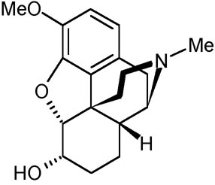
Possible Alternatives:
3. Dihydrocodeine (DF118):
Pharmacodynamics:
Minimal experience as a “take home” analgesic for acute post operative pain in children.
No case series of use in children.
Extensive historical experience in adults but few case series (No studies >20 years)
Number needed to treat (NNT) in adults = 8.1 (DHC 30mg)
  based on only 190 patients
  Confidence interval = 4.1 – 540

Slide 29
Possible Alternatives:
3. Dihydrocodeine (DF118):
Pharmacokinetics:
Majority of analgesia due to parent drug.
Bioavailability = 20%
1/100th the potency of oral morphine
Rapid oral absorption (peak plasma [DHC] = 1.8 hrs)
Elimination T_{1/2} = 4.5 hours

Slide 30
Possible Alternatives:
3. Dihydrocodeine (DF118):
Pharmacokinetics:
Complex metabolism
  Majority = conjugated in liver to Dihydrocodeine -6-glucuronide (DHC-6-G)
  16% N-demethylated (CYP 3A4) to Nordihydrocodeine
  9% O- demethylated (CYP2D6) to Dihydromorphone (DHM)
Dihydromorphone = potent active metabolite

Slide 31
Possible Alternatives:
3. Dihydrocodeine (DF118):
Pharmaceutical:
Licence for use in children aged 4 years or older
Liquid preparation (6% alcohol)
Cheap
Schedule 5 (Misuse of Drugs Regulations 2001)

Slide 32
Summary of Drug alternatives:
 | Codeine | Dihydrocodeine | Tramadol | Oramorph
Pharmacodynamics:
Analgesic Potency | ✚ | ✚ | ✚✚ | ✚✚✚
Safety as prn analgesia at home in children | ✓ ? | ? | ✓ ? | ?
Pharmacokinetics:
Pro drug | Yes | No | No | No
Active metabolite produced by CYP 2D6 | Yes | Yes | Yes | No
Abuse potential | ? | Yes | Yes | Yes
Pharmaceutical:
Licence in children | ? | >3 years | > 11 years | Yes
Child friendly prep? | Yes | Yes | No | Yes
Cost (bottle of syrup): | £0.93 | £3.50 | £3.50 | (£1.78)

Slide 33

What should we do?
National Advice:
No consensus or quality data on how to proceed.
Not clear if other opioids offer any greater margin of safety than codeine in children post tonsillectomy for OSA
1st November 2013
http://www.apagbi.org.uk/news/2013/joint-guidance-statement-use-codeine-children

Slide 34

What should we do?
National advice:
Where a child has received opioids in hospital in the post operative period consideration of the child’s response should influence choice and dose of drug for discharge home
Discuss the approach of your Regional centre and consider a networked approach
Parents must receive education on the correct use of any opioid they may need to use once the child is discharged from hospital

Slide 35

What is happening in my own hospital?
All prescribing regular Paracetamol + Ibuprofen
Confusion / Anxiety – step up analgesia
  Many children sent home with no step up analgesia
  Increased number readmissions 3-4 days post op with inadequate oral intake 2ary inadequate pain relief

Slide 36

What is happening in my own hospital?
Departmental Policy:
Take home step up analgesia to be Oramorph 100mcg/ml
Dispensed in 25 ml bottles.
Labelled to be destroyed after 7 days

Slide 37
Personal Position:
Accept principle of collective responsibility
Comply with a group decision
Personal caseload of adenotonsillectomy
  All under 5 years of age
  Indication for surgery = Sleep disordered Breathing
  High levels of comorbidities
    Down Syndrome
    Other syndromes both named and un-named
    Majority aged <3 years of age
  Undertaking change of practice audit with Tramadol

Slide 38
Personal Position:
Change of practice audit of Tramadol as take home analgesia post tonsillectomy.
Single Surgical Team
  standardised technique
Standardised Anaesthetic technique
  intraoperative morphine titrated to respiratory rate
Standardised population
  Indication for operation = Sleep Disordered Breathing
Standardised take home analgesic regime
  Regular paracetamol and ibuprofen
  Step up Tramadol at 1mg/kg orally prn 6 hrly

Slide 39
Personal Position:
Change of practice audit of Tramadol as take home analgesia post tonsillectomy.
Primary outcome measure =
  Usual level of pain experienced Day 1 – 7 at home as measured by Parent Report 6 point faces scale (Wong and Baker)
  Audit powered to regard change of one face in Usual level as clinically significant
Secondary outcome =
  Number seeking advice from GPs etc in 7 days post surgery
Results:
  ?

Slide 40
What is the way forward for step up analgesia for children after codeine?
How do we provide effective pain relief post tonsillectomy at home?
Pick an analgesic cocktail of your choice and do a local Audit effectiveness
(Large multi centre Audits probably not helpful)
Analgesic Regime – Parental Misconceptions – Child resistance to talking medication – Information / Education provided

Slide 41
What is the way forward for step up analgesia for children after codeine?
How do we provide safe pain relief post tonsillectomy at home?
Use conservative doses for step up analgesics (tempered by in hospital experience)
Good Information provided on what to look out for
National Surveillance for deaths post tonsillectomy at home
  ? Procurator Fiscal system in Scotland

Slide 42
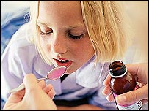

Slide 43
What am I actually doing?
Majority of children sent home on regular paracetamol and ibuprofen
We have agreed a hospital policy (safety in numbers)
We are continuing to use codeine until evidence available on effectiveness / safety of alternative agents.
Patients discharged home with verbal and written instructions of analgesic dosages, drug timings and signs opioid depression warranting contacting the hospital
Exploring mechanisms to actually encourage parents to give post operative medications

Slide 44

Should we continue to use codeine?
Alternatives available:
Oxycodone
Pharmacodynamics:
Potent semi-synthetic opioid
Limited experience of use in children
NNT = 2.4 (CI = 1.5 – 4.9 Adult 15mg)

Slide 45
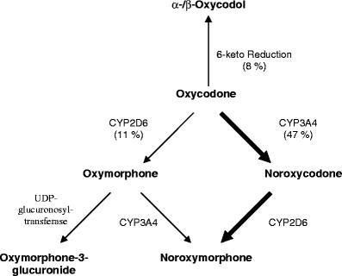
Should we continue to use codeine?
Alternatives available:
Oxycodone
Pharmacokinetics:
Not a pro drug
Oxycodone provides all analgesic effect
Principle metabolism is N-demethylation to noroxycodone by CYP 3A4 enzyme
Active metabolite (oxymorphone) formed from oxycodone by CYP 2D6 enzyme
Bioavailability = 60-87%

Slide 46
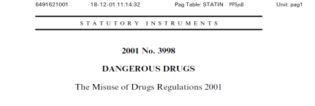
Should we continue to use codeine?
Alternatives available:
Oxycodone
Pharmaceutical:
Product licence for children 12 years and older only
Significant problems with abuse in USA and increasingly Australia
Schedule 2 Drug (Misuse of Drug Regulations 2001)
  Statutory Instrument requiring keeping of a register, locked cabinet storage plus specific regulations on writing of prescription.

Slide 47
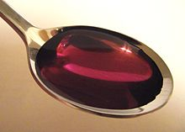
Codeine
Summary:
Not the ideal analgesic agent
Ineffective in significant minority
Risk of death in small number of patients (frequency unknown / undefined)

Slide 48
Codeine
Summary:
Long track record of usage
Safe and effective in the
majority
Palatable
Cheap
No alternative known to be safer.

