Slide 1
Capnography in Recovery
Neal Willis
4th October 2016

Slide 2
What is Capnography?
Bedside monitor
Gives a numerical value
Also gives a WAVEFORM

Slide 3
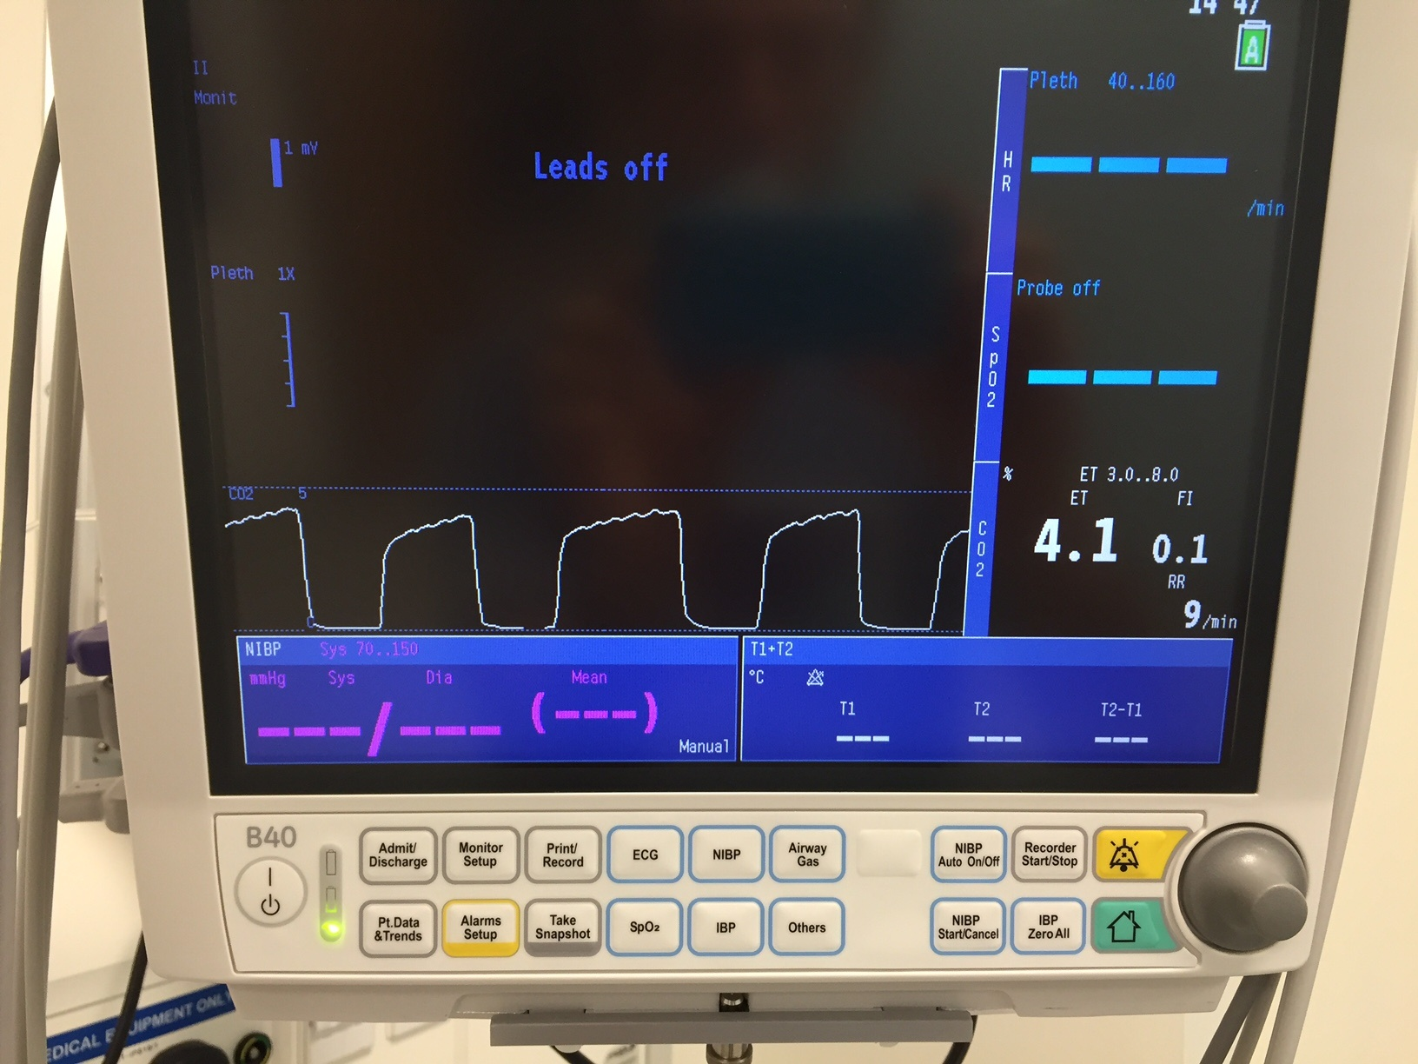

Slide 4
Why are we talking about it?
2011: NAP 4 recommends routine use of capnography in all areas where airway management is occurring
2015: Updated AAGBI guidelines recommend routine use of capnography in recovery
2016: RHC Glasgow are going to implement these guidelines in theatre recovery

Slide 5
Why?
Imagine a patient with an LMA obstructs their airway in recovery while you’re writing down their observations
They’re post-op after having 17 baby teeth extracted

Slide 7
NAP 4
Case report

Slide 8
You said something about cardiac output?
Think about where CO2 comes from
Now imagine the heart stops
OK?
So, how is that relevant to the airway in recovery?

Slide 11
‘SAFE’ Approach
Can you See CO2?
What is the Appearance of the waveform?
What is the Frequency of the waveform?
What is the ETCO2 value?

Slide 12
Example
Can you See CO2?
What is the Appearance of the waveform?
What is the Frequency of the waveform?
What is the ETCO2 value?

Slide 13
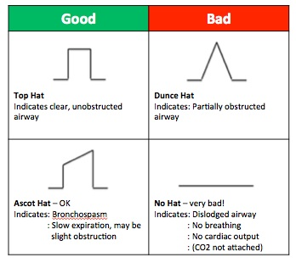
Example

Slide 14
Example
Can you See CO2?
What is the Appearance of the waveform?
What is the Frequency of the waveform?
What is the ETCO2 value?

Slide 15
Example 2
Can you See CO2?
What is the Appearance of the waveform?
What is the Frequency of the waveform?
What is the ETCO2 value?

Slide 17
So What Next?
Workbook
Assessment
Certificate (good for revalidation!)
Hopefully annual recertification
Bedhead signs at each bed space

Slide 18
The Long and Short
Started on Monday 31st October 2016
All patients with an LMA or endotracheal tube will have CO2 monitored in theatre recovery until successful removal of the airway device
New theatre documentation will lag behind by some way, but will include space to document CO2

