Slide 1
“In Reach”
Dr Colin Lang
SPAN
Dunkeld April 2009

Slide 2
Background
SRI & FDRI
Traditional medium sized DGHs
12 miles apart, in Central Belt
Aprox 300,000 population
Both with multiple Surgical & Medical specialties
Different in many ways

Slide 3
Recent Changes in FV
Local Service Reconfiguration
New ways
of working
Geography
Acute Services Centralised
Women & Children
Critical Care
Acute Admissions
Emergency Medicine
EWTD
H@N
PA-As
Consultant delivered service
Subspecialisation

Slide 4
FV Anaesthetics
20 Consultants (2 on-call rotas)
10 SAS
17 Trainees (2 over night resident rotas)
14 Theatres
9 (level 3) ICU beds & 12 (level 2) HDU beds
3500 deliveries per annum
Pain services
Lots of training opportunity

Slide 5
FV Paediatric Workload
800 theatre cases / annum < 15 years old
Wide range in ages
Mostly elective (uro/gen/ent/eyes/ortho)
Average 2 dental lists / week
Other things
A&E resus
Ward
Approx. 1 PICCU transfer / month
& another “causing concern”

Slide 6
“Out Reach to FV”
General & Urology Paediatric Surgery
2 surgeons sharing 40 / 52
Requires Support of
Surgical departments
Management
Medical Paediatrics
Theatres
Anaesthetics

Slide 7
“In reach from FV”
To Anaesthetic Department, Yorkhill
6 /12 pilot, Nov 2008
1 day per week
Mix of mainly ENT / Eyes / Uro / Dental / Endoscopy
Not only day cases
Avoiding the very ill or very small
Service provision
With some healthy scepticism at both ends?

Slide 8
Benefits
Forth Valley
Increased total paediatric caseload
Shares out local paediatric surgical list
Helps keep work local
Improved contacts / communication
Job creation !
Yorkhill
Supports networking?
Supports outreach?
Staffing mix?

Slide 9
Challenges
Planning lists & supervision
Pre assessment & complex patients
Part timer in (both) departments
Fitting in CPD
Contractual stuff
Funding
Leave arrangements
None that were not predicted or surmountable

Slide 10
Future

Slide 11
Future - Larbert
PFI
Reduced beds
Pre assessment / DOSA
Services potentially rationalising
Maxfax
Cardiology
Ophthalmology
Vascular?

Slide 13
Future - Anaesthetics
Staffing
Trainees
>50% reduction?
Training prioritised over service?
Sub – specialised?
1 for every 4 permanent staff?
Elective vs OOH Service
Sub specialisation
Critical mass to sustain any service

Slide 14
Future Networking
Whole Team Approach
Vital
Anaesthetics
Not just paeds anaes
Not just anaesthetics
Surgery
Paediatricians
Others
Organisational
Training
Out reach
In reach
Up date
Regular exposure
What SPAN is about?

Slide 15
Personal Point of View
Very different c/w week of shadowing
Disruptive
Challenging
Stressful
Post CCT?
Revalidation?

Slide 16
Has it been worth it?

Slide 17
Oh Yes
Up skilled
Experience
Confidence
Contacts
On going
My thanks to all the staff in the department in Yorkhill

Slide 18
Next Stages?
Continuation?
Developments?
Education
In Reach
Rotation
Pre assessment
Expansion

Slide 19
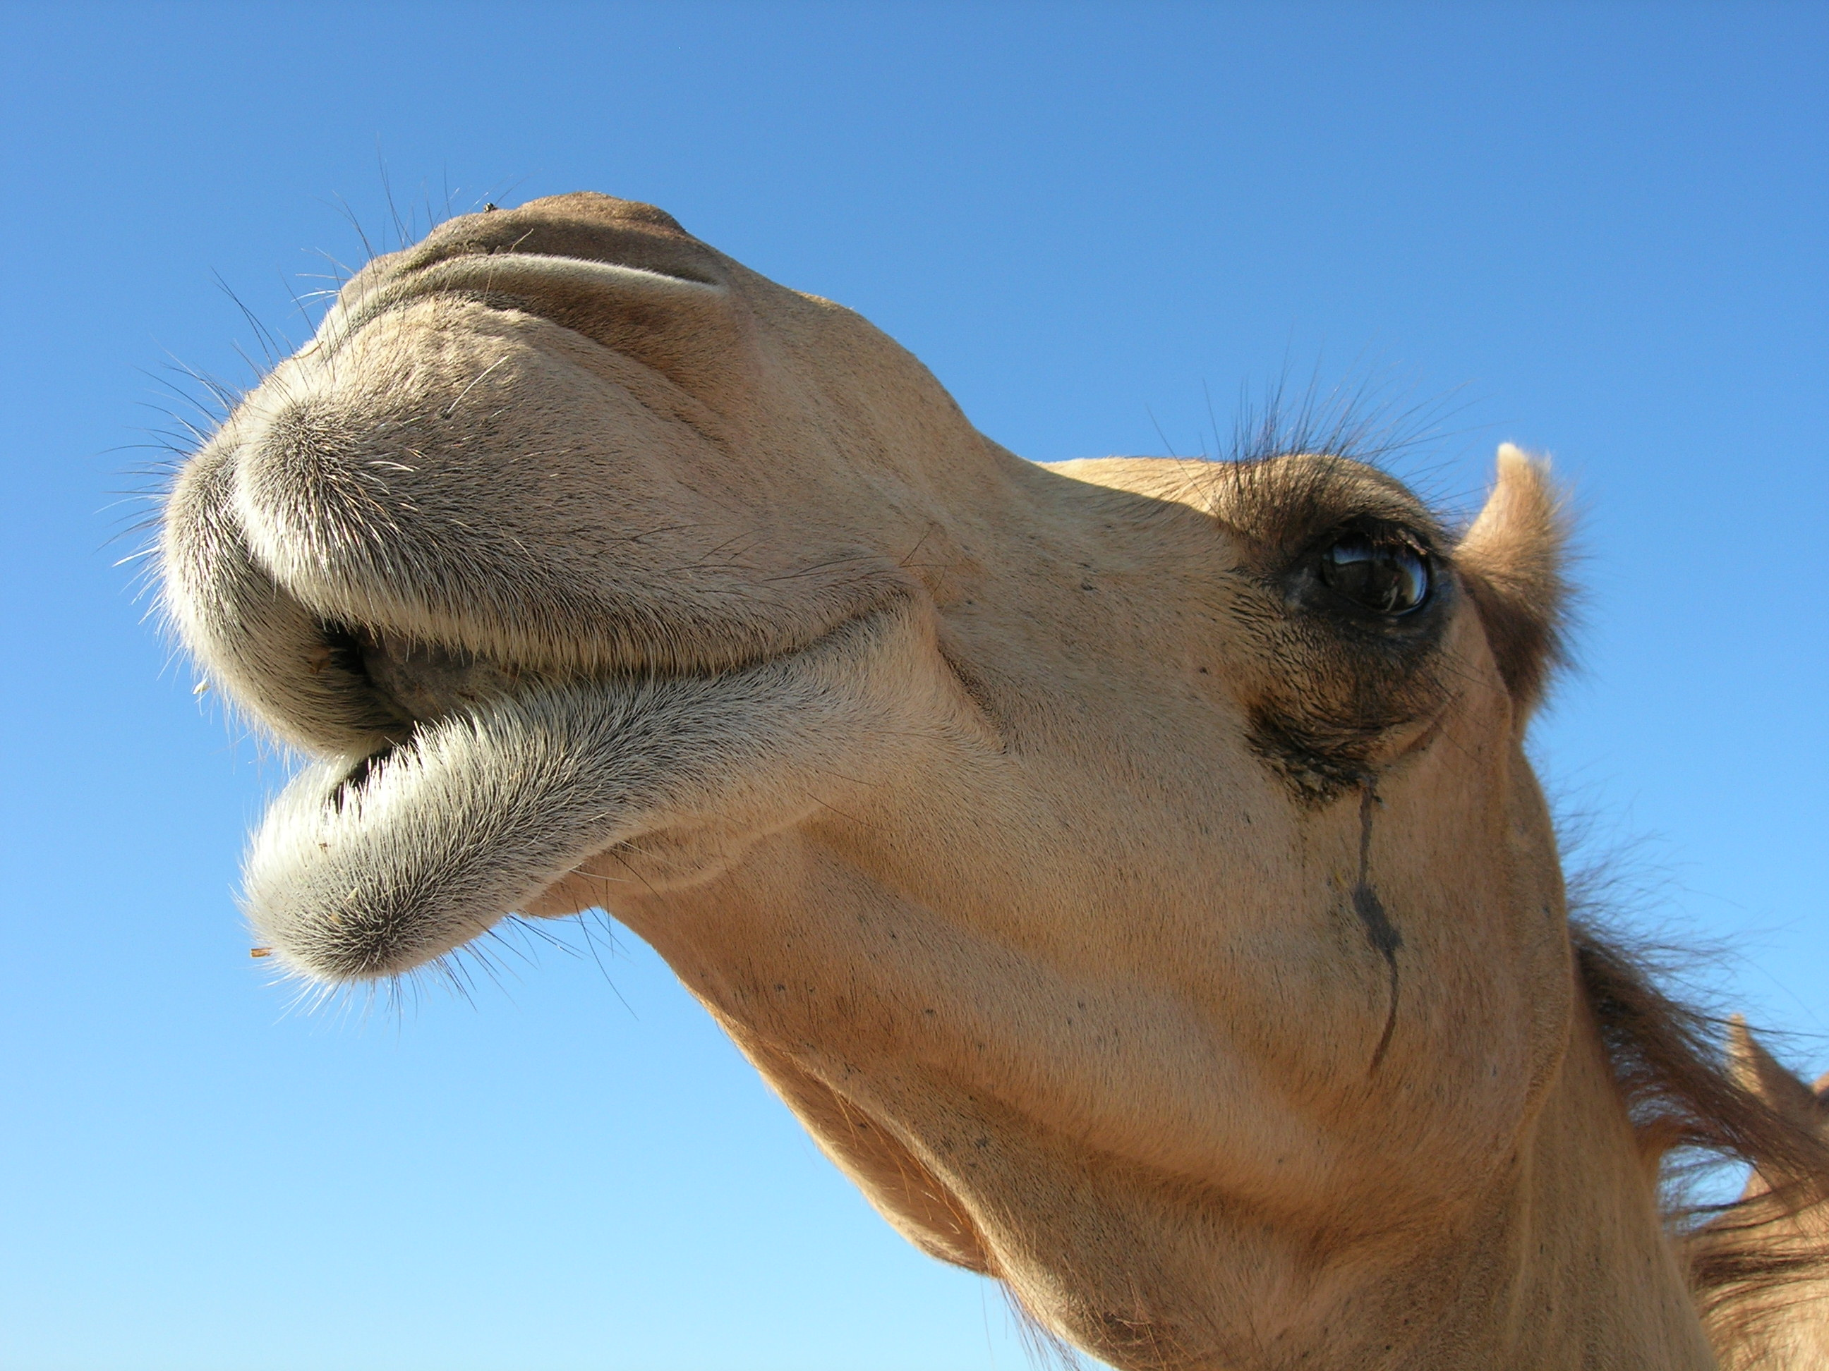
Any Questions?

