Slide 1
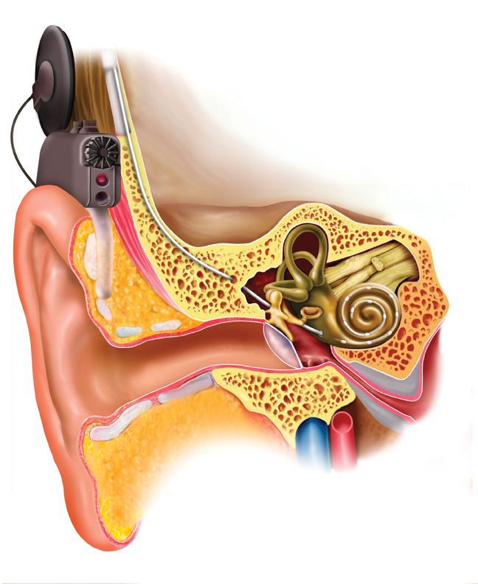
Scottish Paediatric Cochlear Implant Service An Audit of Anaesthesia Safety
Chris Hawksworth
Consultant Anaesthetist
Crosshouse Hospital
Kilmarnock

Slide 2
Scottish Cochlear Implant Service
Service run by Cochlear Department and team of 2 surgeons at Crosshouse Hospital
Anaesthesia required for both MRI/CT/ABR and then Cochlear Implant
3 - 5 hour procedure (bilateral)
If anaesthetist unhappy with patient -> RHSC Glasgow for operation

Slide 3
Why do this audit?
Departmental reasons
Little evidence on anaesthesia safety
Yeh et al, 2011 Laryngoscope 121: 2240-2244
National service at a DGH
No outcomes data for anaesthesia

Slide 4
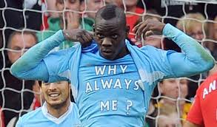
Why do this audit?
Personal reasons – Balotelli syndrome
A few ex-prems still on home oxygen
Noted some infants had occ. VEs
8 kg infant developed runs of broad complex arrhythmia intra op

Slide 5
The audit
Retrospective case note review 2007 -2012
Identified 306 CI ops in patients aged <16
Obtained records for 256 ops

Slide 6
Data collected
Age
Cause of deafness
Co-morbidities
Operation
Uni or bilateral
Re-do
Induction of anaesthesia
ETT tube
Drugs used
Pain scores
PONV
Complications from
anaesthetic chart
recovery notes
ward notes

Slide 7
Age distribution paediatric Cochlear Implants

Slide 8
Cause of Deafness
Syndromic Deafness 18
Wardenburg 5
Pendred 11
Ushers 1
Mohr –Tranebjaerg 1
JLN syndrome 3
Neurological disasters 26
Meningitis, CP/ICH
Connexin gene abnormality 22
Congenital (non-syndromic) 18
The rest, cause unknown

Slide 9
Comorbidities
Neuro-developmental 42
Ex-premature 20
Cardiac 5
Others 3

Slide 10
Type of Procedure
168 children had 256 Cochlear Implant ops
157 unilateral implants
59 bilateral
19 redo

Slide 11
Anaesthetic management
Premeds
LA cream (all but 43 – planned gas inductions)
26 + vallergan + pethidine
17 + vallergan
12 + benzodiazepine
All GAs
40% inhalational induction
60% iv, all but 25 cases used propofol
All anaesthetics given by Consultant or SAS

Slide 12
Anaesthetic management
ETT
All cases intubated
Uncuffed 77%
Cuffed 23% 11 cases microcuff tubes
Maintenance
Des 34 Iso 45 Sevo 175
Air 197 N2O 58
TCI propofol (16 yr old)

Slide 13
Anaesthetic management
Antiemetics
Ondansetron/dexamethasone/cyclizine/stemetil
alone or 2 combined
43 none at all (?vallergan premed)
Analgesia
pre-incision 1% lignocaine + 1:80K adrenaline to skin
Paracetamol/diclofenac
Morphine/fentanyl/remifentanil/pethidine

Slide 14
PONV and Pain
Vomiting
None 2
1 -10x 104
Not recorded 150
Pain scores (max)
Zero 62
1 29
2 12
3 3
Not recorded 150
No pain scores > 2 for more than 2 hours

Slide 15
Complications
Anaesthetic complications
None recorded 222
Something noted 34 cases
Classified complications as
Airway 10
Respiratory 4
Cardiac 9
Recovery 3
Others 8

Slide 16
Airway
ETT in RMB – changed to smaller size (4.0)
ETT dislodged intraop - reintubated
ETT suctioned – secretions ++
Laryngospasm (3)
2 reintubated, 1 had ‘stridor’ post op
ETT changed in AR
incorrect size (6)

Slide 17
Breathing
IPPV with ambubag in recovery (2)
Desaturation on induction, sputum ++
Desaturation + bradycardia at induction
Abandonned (returned weeks later – no problems)

Slide 18
Cardiac/Circulation
Atropine for bradycardia <60 (3)
Ventricular arrhythmias (4)
GTN infusion (?why)
Phenylephrine (hypotensive)
Metoprolol (tachycardia)

Slide 19
Recovery
Delayed recovery 2 - 3 hours
Too much morphine (2) (Locum)
Doxapram (1)

Slide 20
Others
Tooth dislodged
Blister at iv site
iv access issues 3
Temp 38.2 intra-op
No midazolam available for premed
Coughed up blood in recovery

Slide 21
Complications
1 case abandonned, all others safely completed
Small children - laryngospasm
Unexpected respiratory infections
Patients’ family travel a long way
?Reluctance to own up to URTI
Cardiac arrhythmias – LA toxicity

Slide 22
Incidence of anaesthetic complications
36 ‘complications’ in 256 cases
Most considered ‘minor’
Potentially life threatening 14/256 = 5.5%
Yeh et al (2011) 6.5%
Open to interpretation
Data not complete; 50 cases unseen

Slide 23
Who don’t we anaesthetise at Crosshouse?
Problem | Rationale
Leopard syndrome, pulmonary stenosis (operated) ? Resolving HOCM | Sequential CI done at XH as cardiac condition OK'd by cardiologist
Cornelia de Lange syndrome, cleft palate, tracheal diverticulum, laryngo-malacia , stridor | Respiratory physician at referring hospital concerned; no HDU beds at XH
Charge syndrome, repaired cleft lip and TOF, WPW | XH anaesthetist declined - lack of PICU
Ex-prem 23wk, chronic lung disease, | Marked desaturation after CT/MRI, XH anaesthetist decided RHSC safer.
Charge syndrome, repaired cleft lip and TOF, WPW, ex-prem 24 wk, | Some upper lobe collapse on CXR, LMA used for CT ? Aspiration
Bronchopulmonary dysplasia and scoliosis, CP | previous diff intubation, ?Pierre Robin too high risk for XH, no HDU
Being treated for ALL at time of CI | Increased risk of infection therefore done at RHSC

Slide 24
Summary
The majority of children for cochlear implant surgery can be anaesthetised safely in a DGH setting.
Support from RHSC occasionally needed
Care should be taken to ensure full recovery from recent URTIs.
Laryngospasm still an issue in infants
Local Anaesthetic toxicity

